Slide 1
1.1 Number systems
Why hexadecimal is used as a beneficial method of data representation

Slide 2
Why hexadecimal is used in computer science
Denary (base 10) | Hex (base 16) | Binary (base 2)
0 | 0 | 0
1 | 1 | 1
2 | 2 | 10
3 | 3 | 11
4 | 4 | 100
5 | 5 | 101
6 | 6 | 110
7 | 7 | 111
8 | 8 | 1000
9 | 9 | 1001
10 | A | 1010
11 | B | 1011
12 | C | 1100
13 | D | 1101
14 | E | 1110
15 | F | 1111
Base number systems for IGCSE
Base 2: Binary
Base 10: Denary
Base 16: Hexadecimal

Slide 3

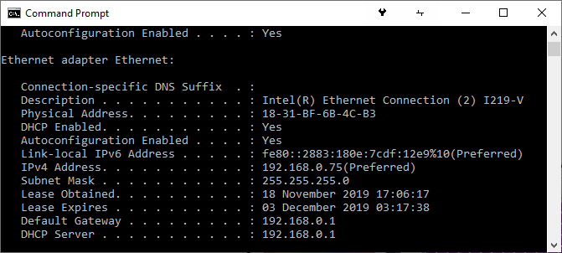
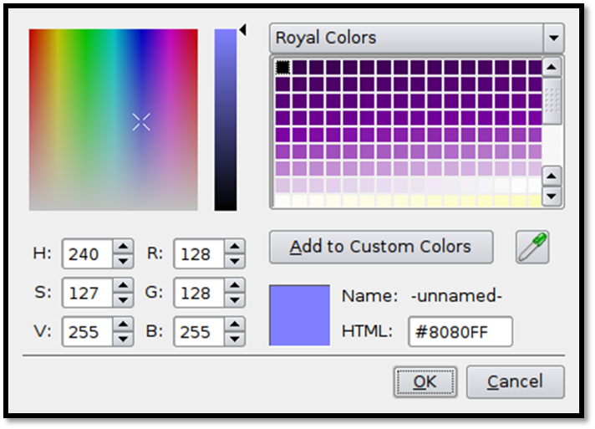
Why hexadecimal is used in computer science
Denary | Binary | Hexadecimal
0 | 0000 | 0
1 | 0001 | 1
2 | 0010 | 2
3 | 0011 | 3
4 | 0100 | 4
5 | 0101 | 5
6 | 0110 | 6
7 | 0111 | 7
8 | 1000 | 8
9 | 1001 | 9
10 | 1010 | A
11 | 1011 | B
12 | 1100 | C
13 | 1101 | D
14 | 1110 | E
15 | 1111 | F

Slide 4
Why hexadecimal is used in computer science
Denary | Binary | Hexadecimal
0 | 0000 | 0
1 | 0001 | 1
2 | 0010 | 2
3 | 0011 | 3
4 | 0100 | 4
5 | 0101 | 5
6 | 0110 | 6
7 | 0111 | 7
8 | 1000 | 8
9 | 1001 | 9
10 | 1010 | A
11 | 1011 | B
12 | 1100 | C
13 | 1101 | D
14 | 1110 | E
15 | 1111 | F

Slide 5
Why hexadecimal is used in computer science
Denary | Binary | Hexadecimal
0 | 0000 | 0
1 | 0001 | 1
2 | 0010 | 2
3 | 0011 | 3
4 | 0100 | 4
5 | 0101 | 5
6 | 0110 | 6
7 | 0111 | 7
8 | 1000 | 8
9 | 1001 | 9
10 | 1010 | A
11 | 1011 | B
12 | 1100 | C
13 | 1101 | D
14 | 1110 | E
15 | 1111 | F

Slide 6
Why hexadecimal is used in computer science
1831BF6B4CB3 in base-16 hexadecimal
=
0001 1000 0011 0001 1011 1111 0110 1011 0100 1100 1011 0011
in base-2 binary
8080FF in base-16 hexadecimal
=
1000 0000 1000 0000 1111 1111
in base-2 binary

Slide 7


